Slide 1
The Battle of Neighbourhoods
By,
Shoukthik Sai

Slide 2
Introduction:
The purpose of this Capstone Project is to help people in exploring better facilities around their neighbourhood. It will help people making smart and efficient decision on selecting great neighbourhood out of numbers of other neighbourhoods in Scarborough, Toronto.
Lots of people are migrating to various states of Canada and needed lots of research for good housing prices and reputed schools for their children. This project is for those people who are looking for better neighbourhoods. For ease of accessing to Cafe, School, Super market, medical shops, grocery shops, mall, theatre, hospital, like minded people, etc.
This Capstone Project aim to create an analysis of features for a people migrating to Scarborough to search a best neighbourhood as a comparative analysis between neighbourhoods. The features include median housing price and better school according to ratings, crime rates of that particular area, road connectivity, weather conditions, good management for emergency, water resources both fresh and waste water and excrement conveyed in sewers and recreational facilities.
It will help people to get awareness of the area and neighbourhood before moving to a new city, state, country or place for their work or to start a new fresh life.
Notes:
Insert a map of your country.

Slide 3
Problem:
To find the answers to the following questions:
List and visualize all major parts of New York City that has great Indian restaurants.
To suggest a better neighbourhood in a new city for the person who are shifting there based on different features.
Which all areas have good housing prizes?
Which is the best place to stay if you prefer good schooling?
Notes:
Insert a picture of one of the geographic features of your country.

Slide 4
Data Section:
For this project we need the following data:
Data Link: https://en.wikipedia.org/wiki/List_of_postal_codes_of_Canada:_M
Foursquare API Data:
We will need data about different venues in different neighbourhoods of that specific borough. In order to gain that information we will use “Foursquare” locational information. Foursquare is a location data provider with information about all manner of venues and events within an area of interest. Such information includes venue names, locations, menus and even photos. As such, the foursquare location platform will be used as the sole data source since all the stated required information can be obtained through the API.
After finding the list of neighbourhoods, we then connect to the Foursquare API to gather information about venues inside each and every neighbourhood. For each neighbourhood, we have chosen the radius to be 100 meter.
Notes:
Insert a picture illustrating a season in your country.

Slide 5
Methodology:
CLUSTERING APPROACH:
To compare the similarities of two cities, we decided to explore neighborhoods, segment them, and group them into clusters to find similar neighborhoods in a big city like New York and Toronto. To be able to do that, we need to cluster data which is a form of unsupervised machine learning: k-means clustering algorithm.
WORK FLOW:
Using credentials of Foursquare API features of near-by places of the neighborhoods would be mined. Due to http request limitations the number of places per neighborhood parameter would reasonably be set to 100 and the radius parameter would be set to 500.
Notes:
Insert a picture of an animal and or plant found in your country.

Slide 6
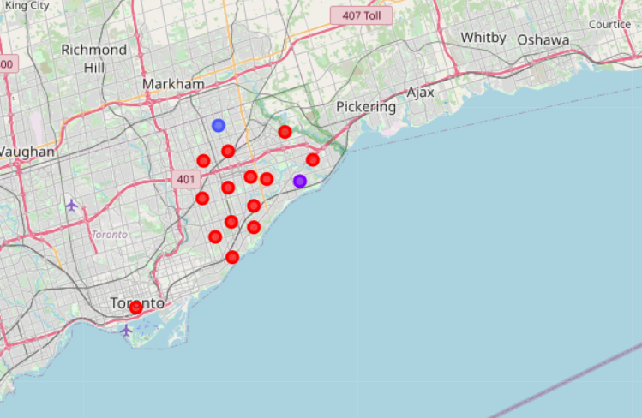
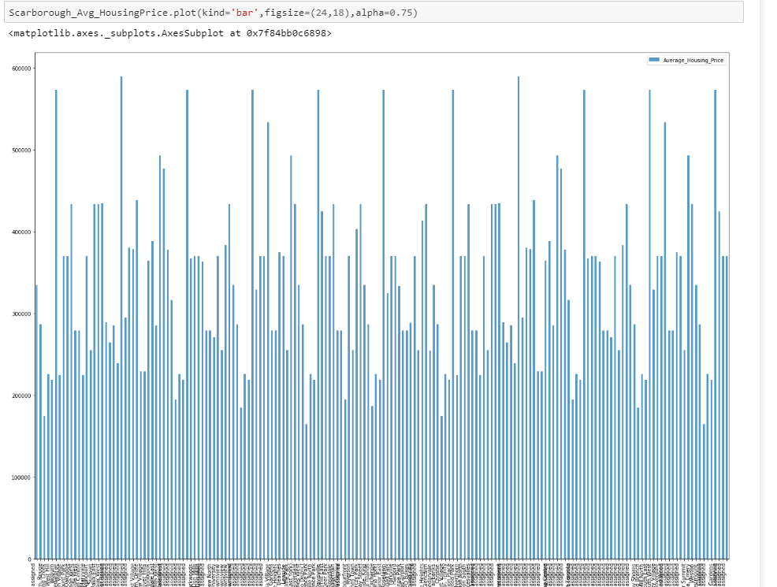
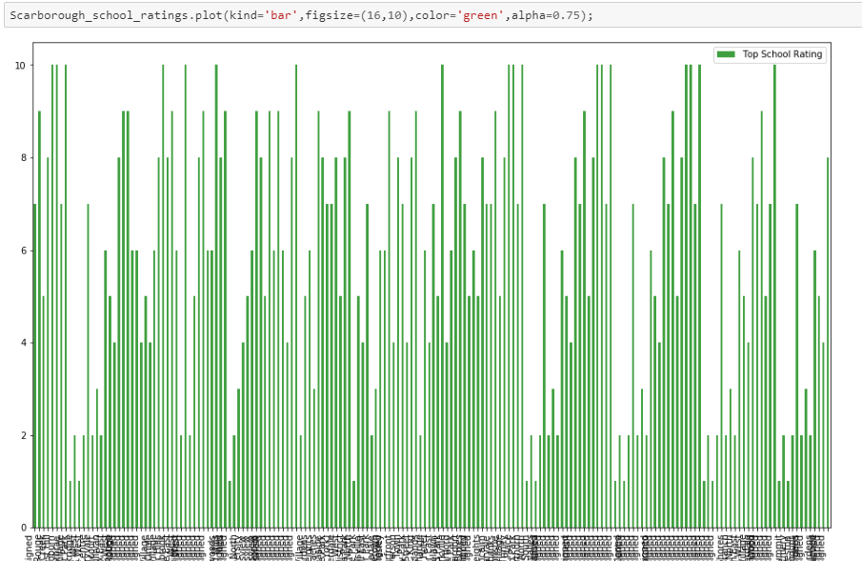
Results

Slide 7
Conclusion:
In this Capstone project, using k-means cluster algorithm I separated the neighbourhood into 10(Ten) different clusters and for 180 different latitude and longitude from dataset, which have very-similar neighbourhoods around them. Using the charts above results presented to a particular neighbourhood based on average house prices and school rating have been made.
I feel rewarded with the efforts and believe this course with all the topics covered is well worthy of appreciation.
This project has shown me a practical application to resolve a real situation that has impacting personal and financial impact using Data Science tools.
The mapping with Folium is a very powerful technique to consolidate information and make the analysis and decision better with confidence.
Notes:
Add key points in the history of your country to the timeline.

